Slide 1
Praying For The Lost

Slide 2
My Heart’s Desire…
Paul has an intense desire to see the Jews saved
The Jews are lost despite having a zeal for God
Their zeal is ‘not according to knowledge’
The lost-ness of the Jews causes Paul intense anguish of heart
He is even prepared to be ‘cut off from Christ’ for them
Paul’s response to their lost-ness is fervent prayer
Romans 10:1-2 Brothers, my heart's desire and prayer to God concerning them is for their salvation! (2) I can testify about them that they have zeal for God, but not according to knowledge.
Romans 9:1-4 I speak the truth in Christ-- (2) that I have intense sorrow and continual anguish in my heart. (3) For I could wish that I myself were cursed and cut off from the Messiah for the benefit of my brothers, my countrymen by physical descent. (4) They are Israelites, and to them belong the adoption, the glory, the covenants, the giving of the law, the temple service, and the promises.

Slide 3
How Lost Are The Lost?
Dead
Alienated
Enslaved
In Darkness
Degraded
Despisers of The Cross
Hardened
Blinded
Ephesians 2:1-5
Ephesians 4:18-19
Galatians 4:8
Colossians 1:21, 2:13
Romans 1:20-32
1 Corinthians 1:18
2 Corinthians 2:15,16
2 Corinthians 4:3,4

Slide 4
What Is The Fate Of The Lost?
Are Perishing: John3:14-16, 10:28 2 Thessalonians 2:10 2 Peter 3:9
Are Under God’s Wrath: John 3:36 Romans 1:18, 2:5-8 Ephesians 2:3; 5:5,6 Colossians 3:5,6
Are To Be Punished: Mark 9:42-48, Isaiah 66:24 Matthew 13:42,50 2 Thessalonians 1:8,9

Slide 5
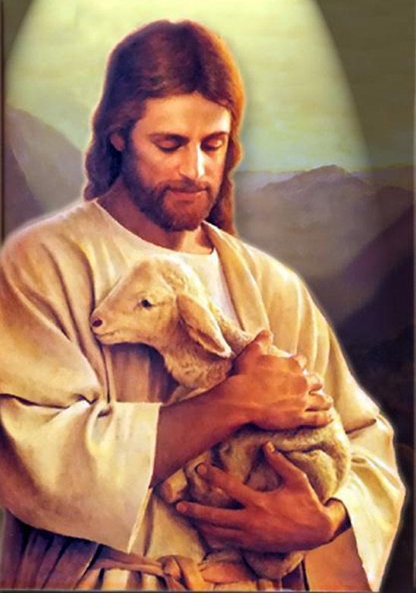
Jesus And The Lost…
Matthew 18:11-13, Luke 19:10
Luke 15:1-32
John 17:12, 18:9
2 Peter 3:9
1 Timothy 1:15

Slide 6
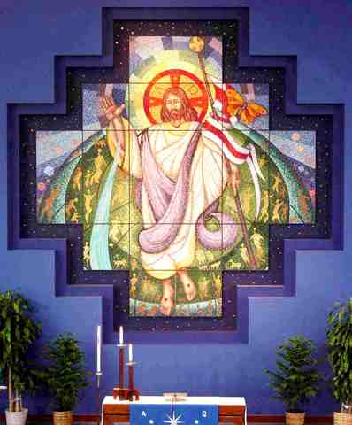
Praying For The Lost
Acts 26:18 in order to open their eyes so that they may turn from darkness to light, and from the authority of Satan to God, so that they may receive remission of sins and an inheritance among those who are sanctified by faith in Me.
That they may have the ‘eyes of their understanding’ opened to see Christ (Ephesians 1:18)
That demonic bondages may be broken (Galatians 4:8)
That they may hear of Christ (Romans 10:17)

Slide 7
Praying On The Basis Of Redemption
You claim people ‘because Christ has died for them on the cross’
Colossians 1:13-15
2 Corinthians 5:14,15
1 Timothy 2:5,6
Hebrews 2:9
Hebrews 10:10

Slide 8
Pray For Interest In Spiritual Things
For a curiosity about the Bible
For a curiosity about some uniquely Christian doctrines
For a curiosity about God’s delivering and healing miracles
For a curiosity about the person of Jesus
They will soon be: ‘not far from the Kingdom of God’ Mark 12:34

Slide 9
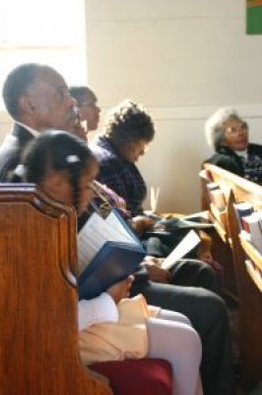
Pray That They Might Have Good Christian Friends
The gospel travels most often via relationships
Pray that the person may suddenly acquire a bunch of Christian friends
Pray that there may be at least one clear good witness to Christ among them
Also pray that ‘bad company’ may depart

Slide 10
Believe That They Will Be Saved
Good evangelists see evangelism as easy – they BELIEVE that people will be saved
Poor evangelists see evangelism as complicated, risky and difficult and do NOT REALLY BELIEVE that people will be saved
We must deploy our faith and ‘believe that we have received’ Mark 11:23,24
We must create an inner vision of people becoming saved in large numbers
‘Praying Hyde’ of India got the exact number of people saved that he had faith to pray in for salvation.

Slide 11
Praying For Their Governments
When ‘kings and those in authority’ are converted often the whole society is evangelized (Samoa)
When those in authority hinder the gospel often very few are saved. (Romania)
People are trapped in structures that try prohibit their salvation (families, nations, belief systems etc) and we must wrestle against such things
1 Timothy 2:1-4 First of all, then, I exhort that supplications, prayers, intercessions, and giving of thanks be made for all men, (2) for kings and all who are in authority, so that we may lead a quiet and peaceable life in all godliness and reverence. (3) For this is good and acceptable in the sight of God our Savior, (4) who will have all men to be saved and to come to the knowledge of the truth.

Slide 12
Prevail and Persist In Prayer For Souls
Share Paul’s agony for the lost-ness of souls (Romans 10:1-3)
Pray persistently (Luke 18:1-8)
Get with others so that you have the power of multiplication… (Matthew 18:19,20 ; Leviticus 26:8; Deuteronomy 32:30;

